Slide 1


Comparative Analysis of Image Classification Models for Efficient and Accurate Classification across Noisy Vegetable Images
Class 6917:
Guided research methodologies
by Yusif Mukhtarov 07.31.2023

Slide 2
Project objective
Primary objective: Noisy image classification without denoising techniques
Why is it needed if there are denoising techniques?
2.1 Direct classification of images takes less time and efficiency.
2.2 In real world scenarios some images cannot be perfectly denoised.
2.3 Preservation of information: Some valuable information can be lost during denoising techniques, impacting the classification performance
2.4 Transferability: A model which can classify noisy images could be transferable to other domains where denoising is not available or feasible. (Medical Imaging, Astronomical Imaging...)
3. Application area: Agriculture, food processing, retail and supply chain
management…

Slide 3
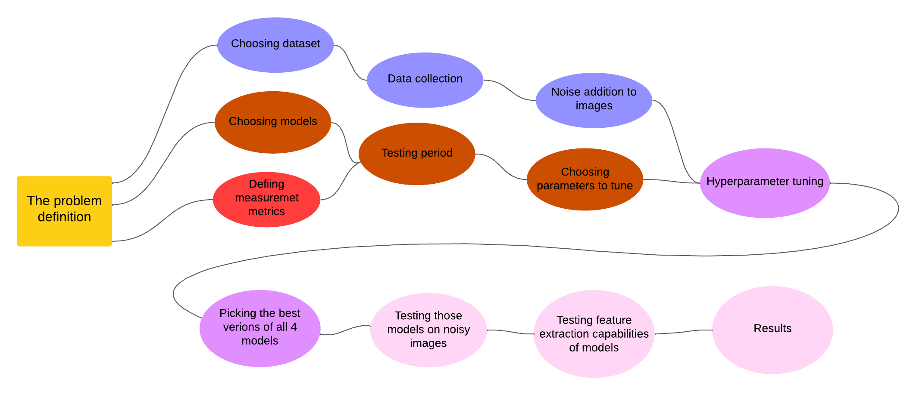
Project objective
Architecture diagram

Slide 4
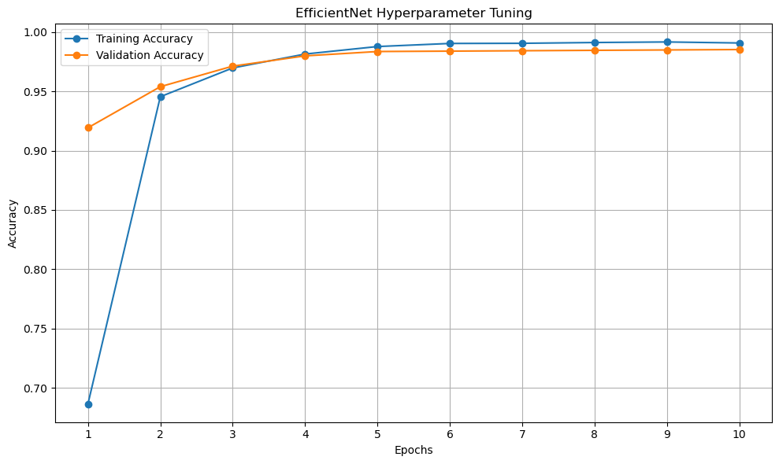
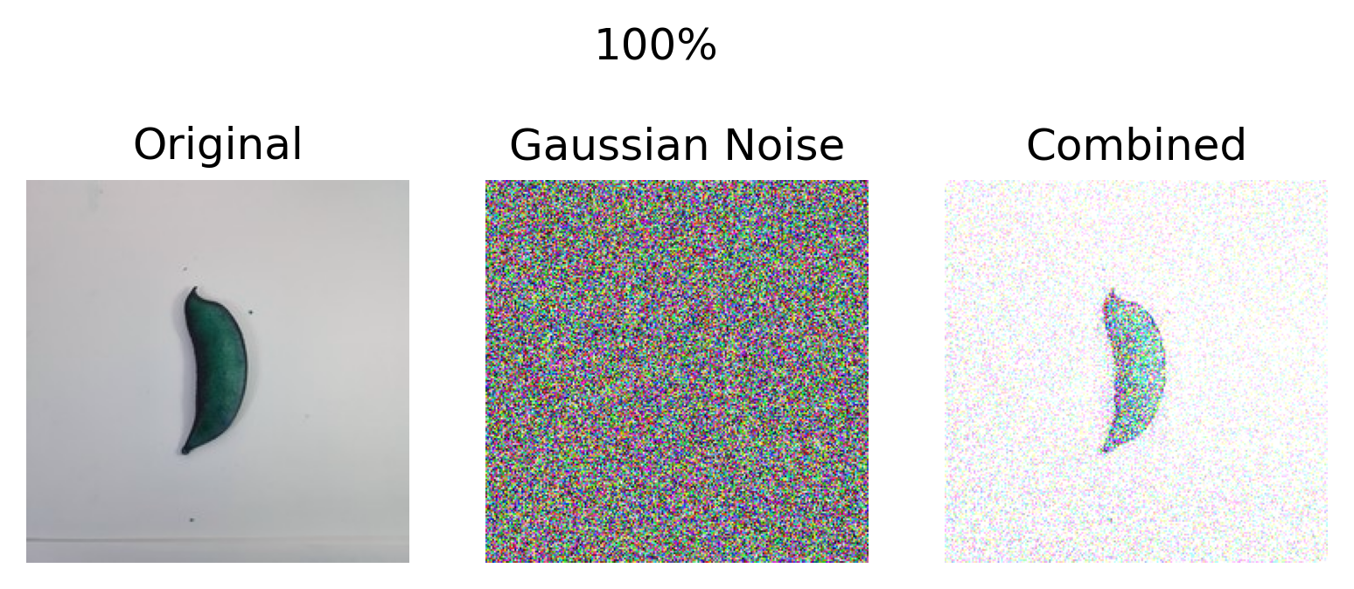
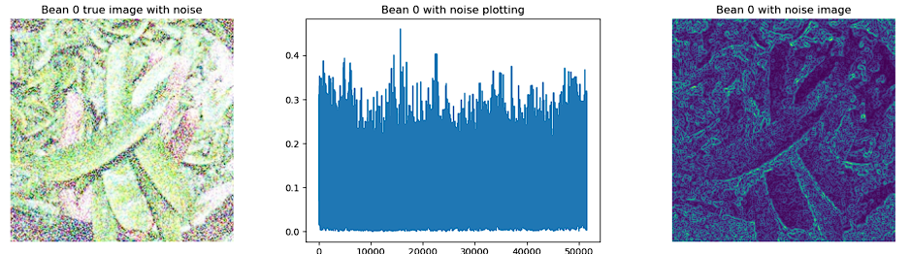
Project objective
Steps
Models. AlexNet, VGG16, EfficientNet, and ResNet
Dataset. Vegetable image dataset
Noise. Gaussian Noise
Hyperparameters tuning. Learning rate scheduler gamma and step size, momentum.
Testing on metrics. Accuracy, precision, and recall.
Result and feature extraction analysis.
4. Training procedure
6. Feature extraction analyses
3. Adding noise

Slide 5
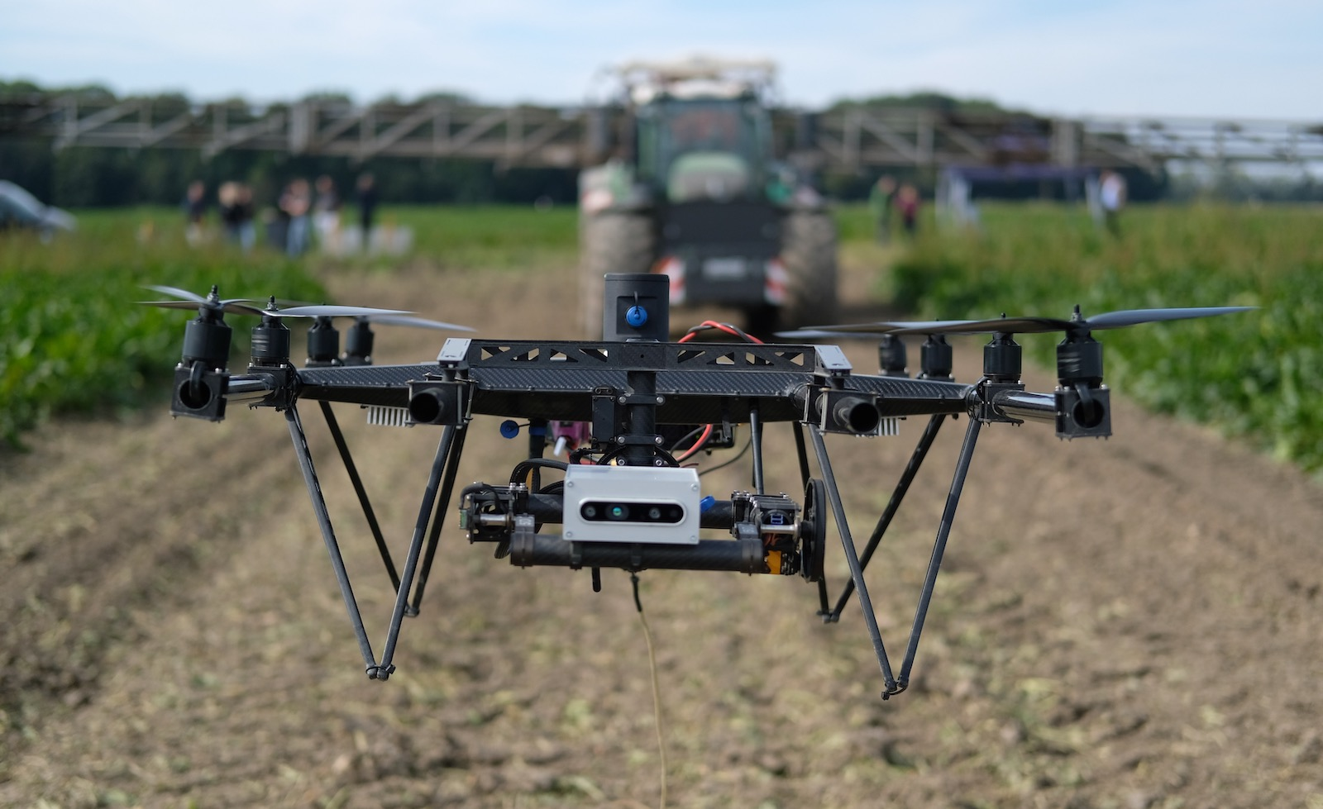
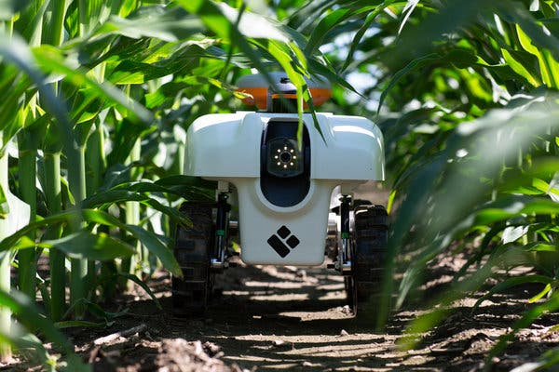
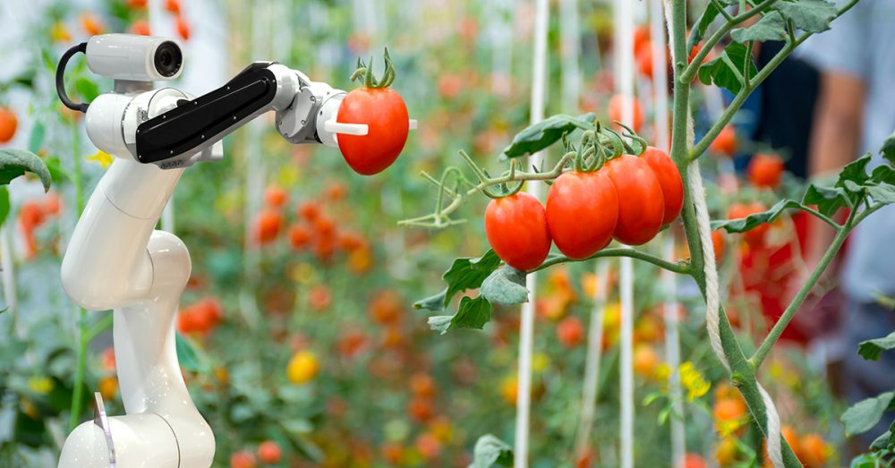
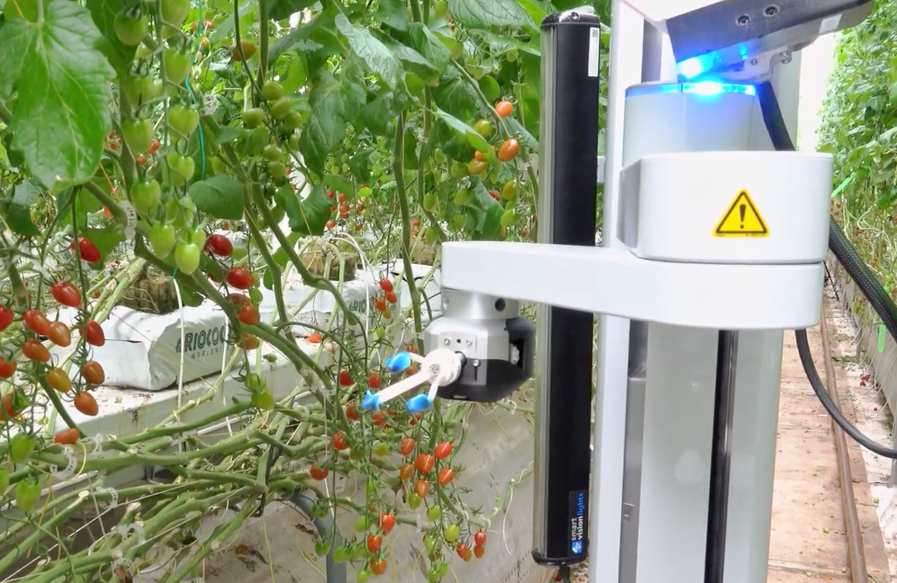
Project objective
Why is it needed if there are denoising techniques? Uniqueness of the project
Time
Not all images can be perfectly denoised
Preservation of information
Computational power

Slide 6
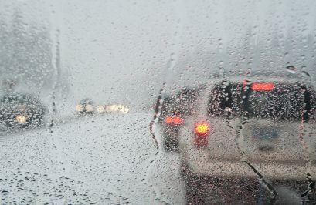
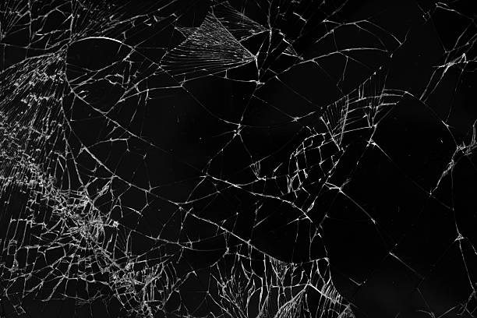
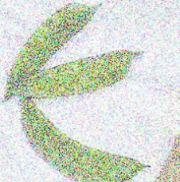
Project objective
Better than denoising techniques Uniqueness of the project
Direct classification of models. Less time and computational power.
Generalization. There might be new noisy images
Transferability

Slide 7
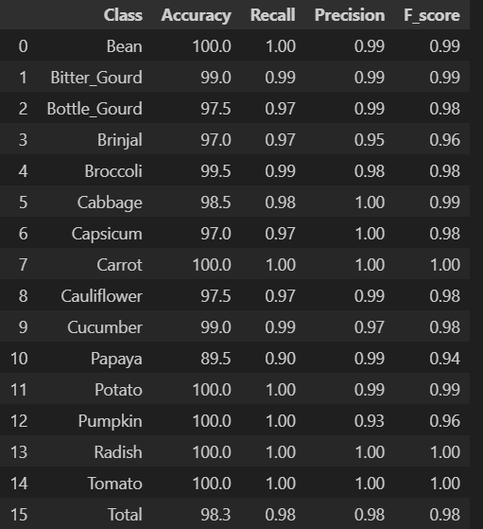
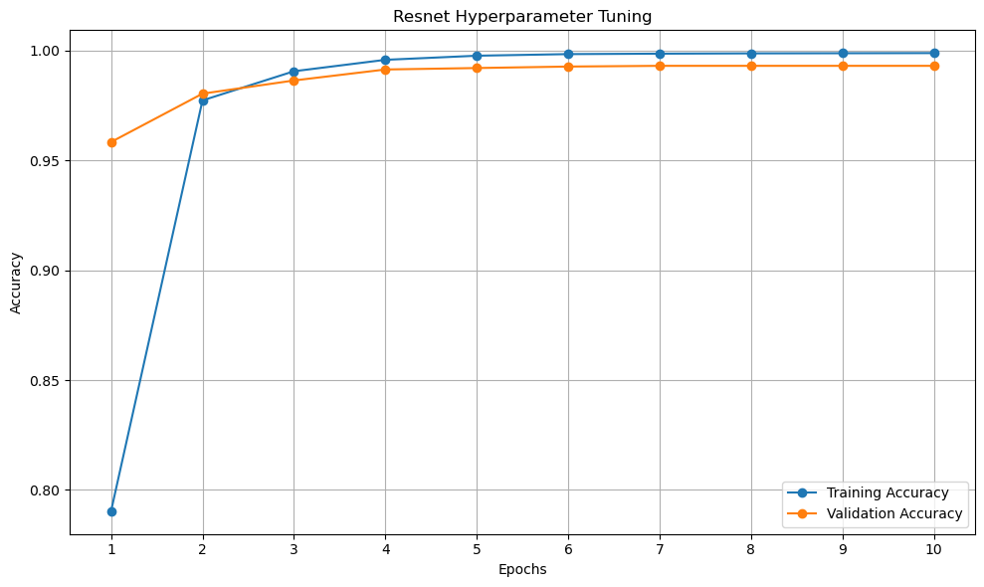
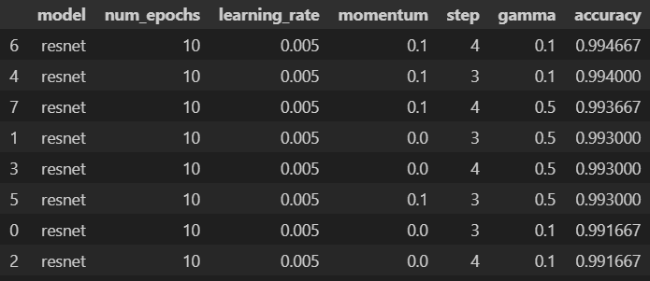
Results. AlexNet

Slide 8
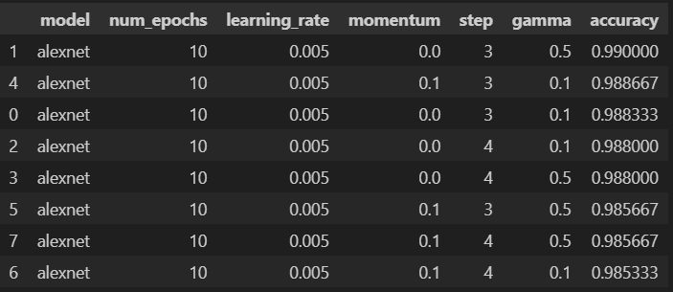
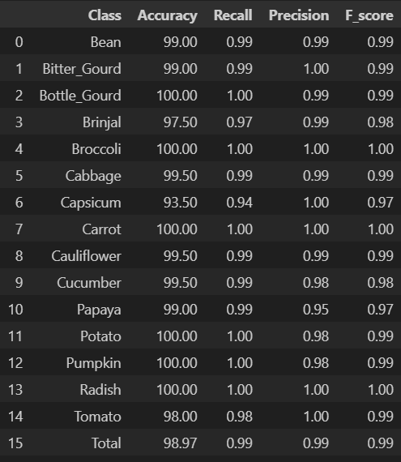
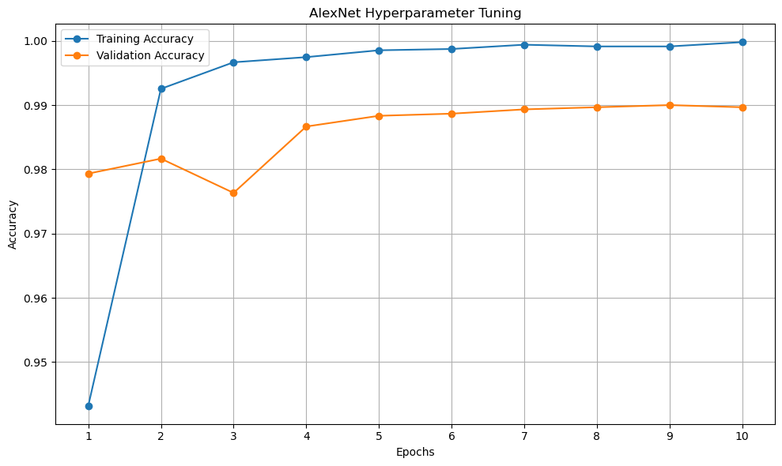
Results. Resnet.

Slide 9
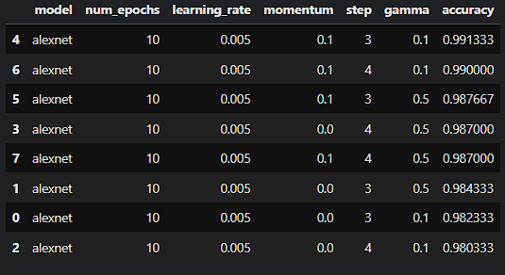
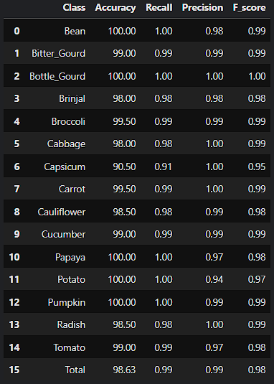
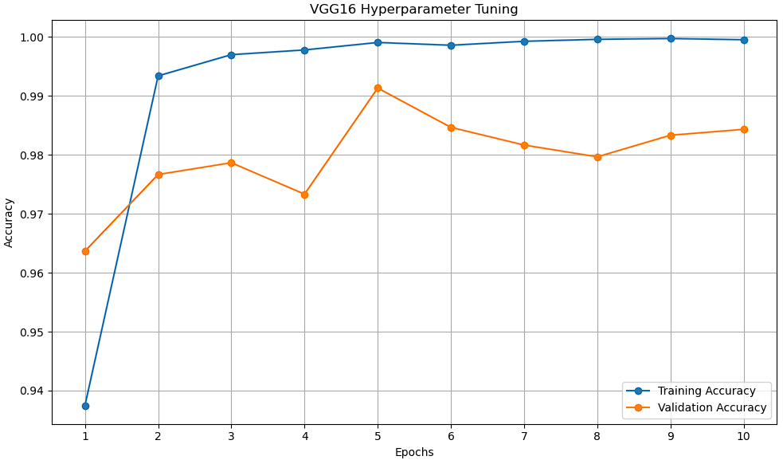
Results. VGG16.

Slide 10
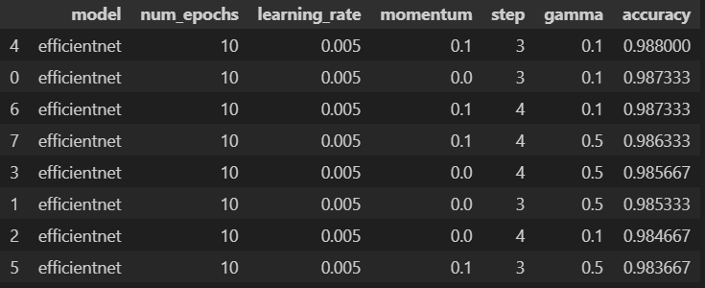
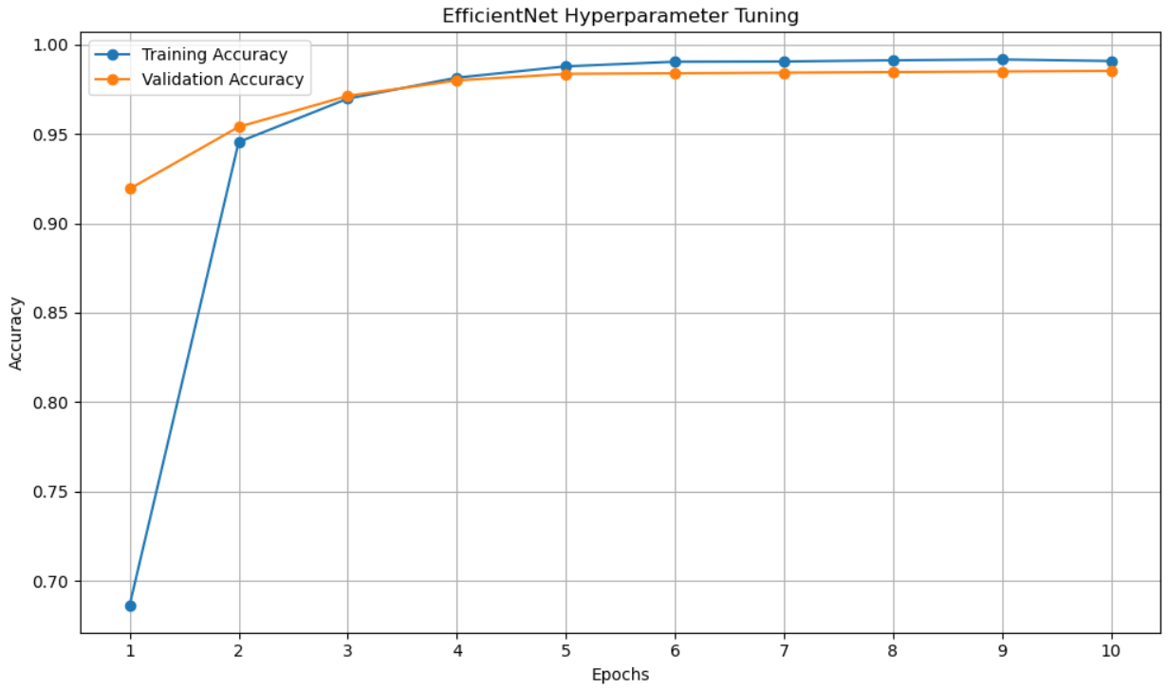
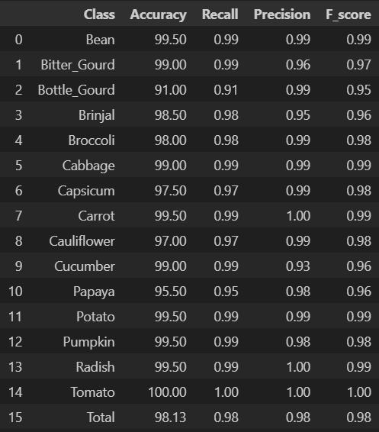
Results. EfficientNet.

Slide 11
Conclusion
The best model is chosen
The best models for all vegetables are chosen
Feature extraction analyses are done

Slide 12
Future work
Ensemble learning.
Customized CNNs.
Improving transferability of images trained on noisy images.

